Slide 1

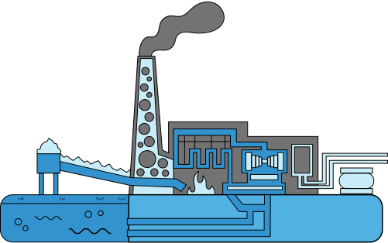

Smart Water Distribution & Irrigation Management System
* Course: Database Development with PL/SQL (INSY 8311)
* Student Name: Charles Murenzi
* Student ID: 27386
* Institution: Adventist University of Central Africa (AUCA)
* Lecturer: Mr. Eric Maniraguha
* Academic Year: 2025–2026

Slide 2




Project Overview
**Objective:**
To design and implement an automated system for tracking water consumption and irrigation activities using Oracle PL/SQL.
**Problem Addressed:**
* Manual water tracking causes errors and delays
* Lack of real-time reporting
* Poor auditability and decision-making challenges
System Scope:**
* Districts, sectors, irrigation zones
* Automated validation and auditing
* BI-ready data for analytics
**Expected Outcomes:**
* Accurate consumption tracking
* Enforced business rules
* Improved operational efficiency

Slide 3
Business Process Modeling (BPMN)
**Purpose:**
To visually model how water consumption data flows through the system.
**Key Actors:**
* Water Meter Administrator
* Field Technician / Employee
* System / Database
* Auditor / Manager
**Main Process Flow:**
* Record water consumption
* Validate meter and date rules
* Store data securely
* Log all actions
* Update dashboards
*Benefit:**
Ensures clarity, accountability,
standardized operations.

Slide 4
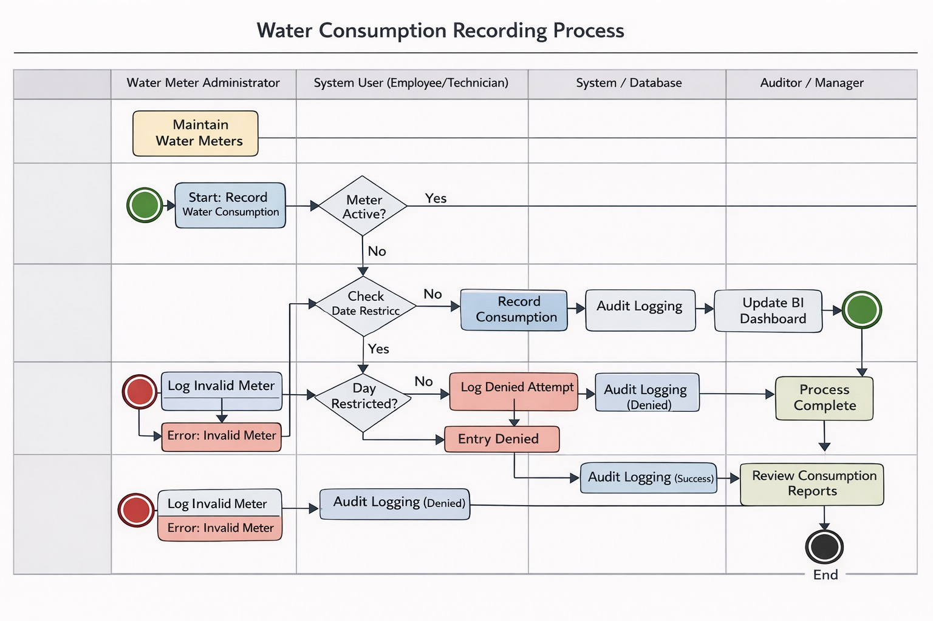

Slide 5
Database Creation
PDB Name: `Thur_27386_charles_SWIT_DB
* Admin User: `switracker`
* Dedicated tablespaces for data, indexes, and temp
**Outcome:**
* Secure, scalable, and production-ready database environment
Database Environment:
Oracle Database 21c XE
Pluggable Database (PDB)

Slide 6
Table Implementation & Data Insertion
  Implementation Activities:
  Created all physical tables
  Applied constraints (PK, FK, NOT NULL, CHECK)
  Created indexes for performance
  Data Population:
  Inserted realistic test data
  Covered normal and edge cases
Validation:
  Constraint enforcement tested
  Multi-table queries verified
  Result:
  Reliable and consistent dataset for application logic and BI.

Slide 7
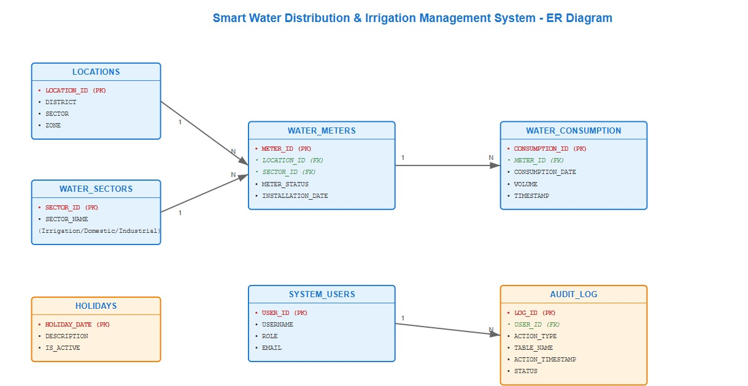

Slide 8
Database Interaction & Transactions
L/SQL Components Implemented:
Functions for validation and calculations
Procedures for logging and transactions
Cursors for multi-row processing
Window functions for analytics
Package Used:
switracker_pkg
Centralized logic and exception handling
Benefit:
Reusable, maintainable
secure database logic

Slide 9
Advanced Programming & Auditing
Business Rule Enforced:**
No INSERT, UPDATE, DELETE on weekdays
No DML on public holidays
Only weekends allowed
Technical Implementation:**
* Triggers for restriction enforcement
* Audit triggers for logging all actions
Audit Features:
User tracking
Action type
Timestamp
Status (ALLOWED / DENIED)
Outcome:
Strong compliance and full traceability.

Slide 10
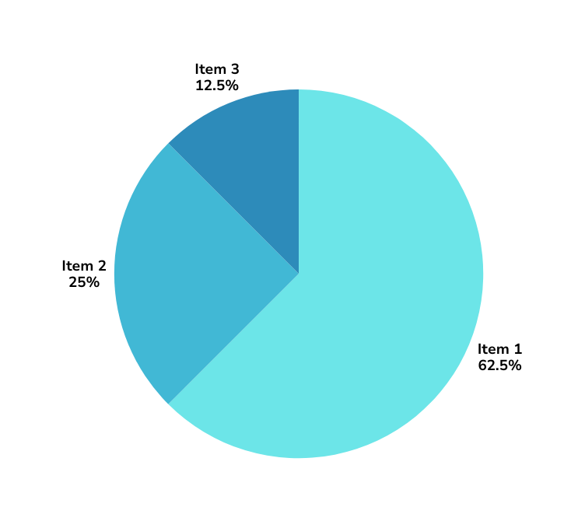
Business Intelligence
Consumption trends per sector
* Meter performance analysis
* Audit compliance dashboards
Decision Support:
  Leak detection
  Resource planning
  Policy evaluation

Slide 11
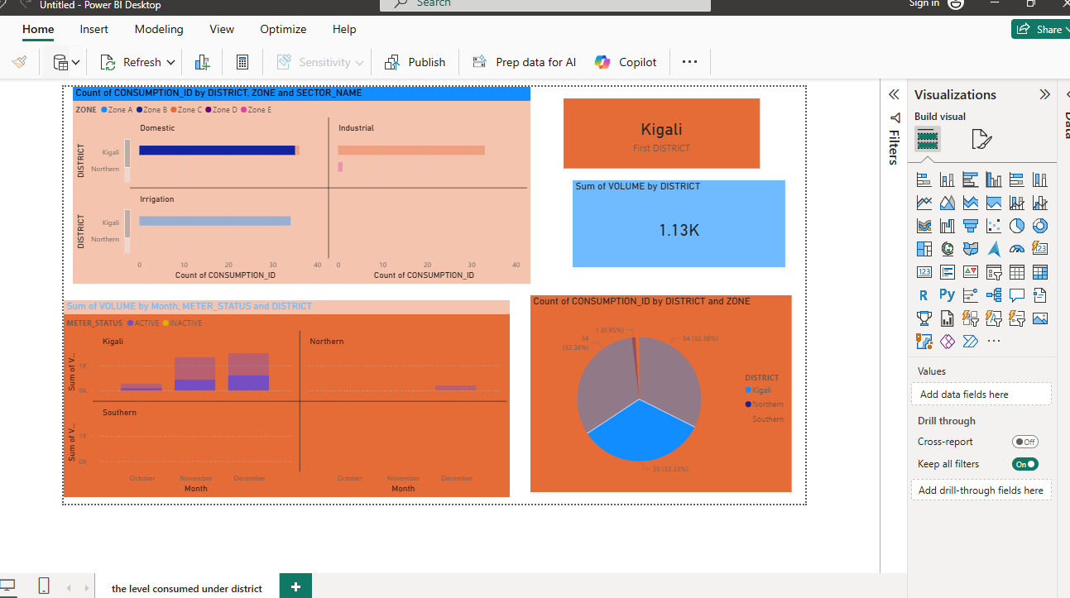

Slide 12
Conclusion & Key Achievements
**Project Achievements:**
* Fully functional PL/SQL-based system
* Enforced real-world business rules
* Auditable and secure database design
* BI-ready data model
**Final Statement:**
This project demonstrates practical application of database development principles in solving real-world water management challenges.

Slide 13
Thank You

